Slide 1
Efficient & Flexible Hyperparameter Optimization
Dan Ryan
PyData Miami 2019

Slide 2
Acknowledgements
This is not my work! I am just a big fan evangelizing. The credit goes to the AutoML group at University of Freiburg, in particular:
Stefan Falkner
Aaron Klein
Frank Hutter
Matthias Feurer
They are the authors of the BOHB paper and the first chapter of the forthcoming book: “Automatic Machine Learning: Methods, Systems, Challenges”.

Slide 3
What is Hyperparameter Optimization?
Most ML algorithms need parameters specified by the user prior to running (they are not learned by the algorithm looking at data). These are hyperparameters.
Using an algorithm to learn good values for these hyperparameters is hyperparameter optimization (HPO).
Using an algorithm to learn a complete end-to-end ML pipeline is referred to as AutoML and includes:
Algorithm Choice
Preprocessing / Feature Engineering / Feature Selection
HPO
Ensembling

Slide 4
Why HPO?
Practically all algorithms can have significant performance gains by tuning their hyperparameters for each dataset.
Default settings are not your friend and they won’t have their feelings hurt when you change them
No, there is not one learning rate to rule them all
In order to make valid comparisons between the performance of different algorithms on a dataset it is important that they are all properly tuned to good settings.

Slide 5
Slot Machine, Slave Labor, or Algorithm?
Many people manually tune hyperparameters. Would you ever manually tune the regression coefficients of your GLM? Even if you are “really good” at it?
Variable Ratio Reinforcement Schedule = Slot Machine
“Graduate Student Descent” = Slave Labor
We are doing data science, so use an algorithm!
Take the time to learn a good open source library for HPO and never go back to the casino.

Slide 6
HPO Problem Formulation
HPO is a hard optimization problem. It is essentially trying to optimize a black box function where:
Domain = Hyperparameter configuration space
Range = Real numbers (performance of model on test set)
Expensive evaluation of the function being optimized (train the ML model and measure its performance)
Noisy function evaluation (validation performance approximates test set performance)
No gradient information available

Slide 7
What qualities make a good HPO algorithm?
Flexible: It allows for complicated hyperparameter configuration spaces (real, integer, categorical, conditional, high dimension)
Efficient: It has a good runtime for each step of the algorithm.
Effective: It can find good hyperparameters with a fairly small number of steps.
Scalable: Algorithm steps can be run in parallel.
Robust: Algorithm works on most problems “out of the box”. Eventually will find good solution.
Easy: Well designed and maintained open source library available.
Doesn’t Eat or Sleep: Seriously, stop going to the casino.

Slide 8
Model Free Methods
Search over the domain (sometimes intelligently) without ever trying to explicitly model the mapping from domain (HP configuration space) to the range (test set performance).
Grid Search (Do not use unless all hyperparameters are discrete!)
Random Search
Heuristic Search (ACO, PSO)
Evolutionary Algorithms / Genetic Programming
Multi-resolution Algorithms (Successive Halving, Hyperband)
They generally require more function evaluations than model based methods (Flexible, Efficient, Scalable, but not Effective).

Slide 9
Model Based Methods (Bayesian Optimization)
Define a surrogate model that will be used to approximate the mapping from configuration space to test set performance and the uncertainty about the mapping.
Gaussian Processes (Spearmint, skopt)
Random Forest (SMAC)
Bayesian Neural Networks
TPE (Tree-structured Parzen Estimator) (hyperopt)
At each step of the algorithm, use the surrogate model and an acquisition function to choose the next configuration to evaluate.
Expected Improvement (most common choice)
Probability of Improvement
Minimizing Conditional Entropy

Slide 10
Successive Halving
Assumes that the algorithm can be run on a limited compute budget and an approximate low fidelity validation score obtained.
Randomly sample a number of configurations in parallel and run for short amount of time.
At end of time interval, keep only best fraction (.25 to .5) of the configurations based on performance so far.
Run remaining configurations longer.
Repeat until maximum budget is reached.
Figure taken from “Automatic Machine Learning: Methods, Systems, Challenges”, Chapter 1.

Slide 11
HyperBand
The performance of Successive Halving can be sensitive to the number of culling steps performed before reaching the maximum budget per run (not Robust).
HyperBand solves this by evenly splitting resources between running Successive Halving with multiple values of this sensitive hyper-hyperparameter.
All values between the extremes of no culling (random search) and aggressive culling (very large number of with many steps of culling) are tried.
Hyperband shows good performance across many problems, but is still randomly sampling configurations (model free), so is not the most Effective.

Slide 12
BOHB (Bayesian Optimization and HyperBand)
Introduced at ICML 2018 by AutoML group at University of Freiburg.
Start with vanilla HyperBand but store all validation scores for each (config, budget) pair run.
When a sufficient amount of data has been collected for a budget, fit a TPE surrogate model and start using this for future configuration selection.
Use surrogate model for largest budget with enough available data.
Continue to sample random configurations with some small frequency for robustness guarantees.

Slide 13
BOHB Performance
Fast progress from the start (HyperBand) with strong final performance (BO).
Figure taken from “BOHB: Robust and Efficient Hyperparameter Optimization at Scale”, ICML 2018.

Slide 14
Hpbandster (HyperBand on STERoids)
A very thoughtfully architectured HPO library with an implementation of BOHB.
Looks like it will be well maintained going forward.
You can plug and play your own HPO algorithm to work with it too.
Very flexible and intuitive configuration space definition.
Multi node scalability due to component architecture:
Master (the brains – configuration selection)
Worker (the muscle – configuration evaluation)
Nameserver and Dispatcher (the organizers)

Slide 15
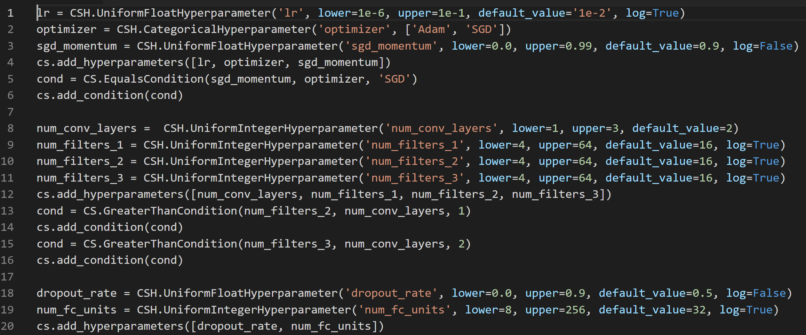
Example Configuration (PyTorch Conv Net)

Slide 16
Other HPO & AutoML Libraries / Resources
HPO
Hyperopt
Spearmint
SMAC
Skopt
www.sigopt.com
AutoML
Auto-sklearn
TPOT (The Data Science Assistant)
Hyperopt-sklearn
Auto-WEKA (and pyautoweka)
H20 AutoML
Google Cloud AutoML

Slide 17
References and Suggested Reading
“BOHB: Robust and Efficient Hyperparameter Optimization at Scale”, Falkner, Klein, Hutter (2018)
“Hyperband: A Novel Bandit-Based Approach to Hyperparameter Optimization”, Li et. al. (2017)
“Automatic Machine Learning: Methods, Systems, Challenges”, Chapter 1, Feurer, Hutter, Draft
“Algorithms for Hyper-Parameter Optimization”, Bergstra et. al. (2011)

Slide 18
Thank You
Dan Ryan
Data Scientist, NextEra Energy
https://www.linkedin.com/in/drdanryan/
@drdanielryan

